Slide 1
Intro to Data Science
Jonathan Joa
Scott McAllister

Slide 2
Topics
What is Data Science?
Why Learn Data Science?
Netflix Example
Data Science Roles
Data Science Project Workflow
Federal Government Example
Why Python and R?
Python vs R
Setting expectations on what we’ll learn

Slide 3
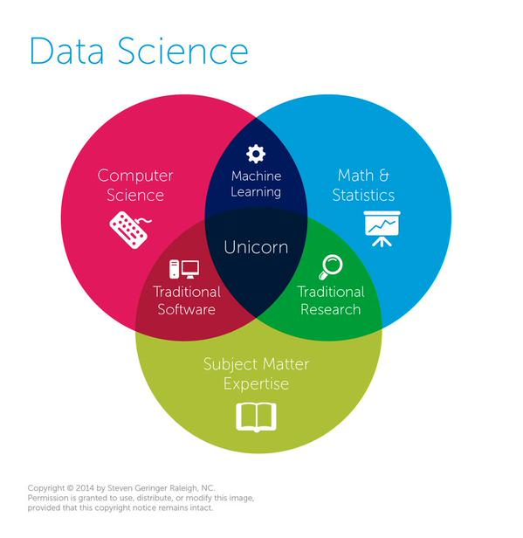
What is Data Science?
Tools and techniques for data analysis
Problem-solving
Applying scientific techniques to practical problems

Slide 4
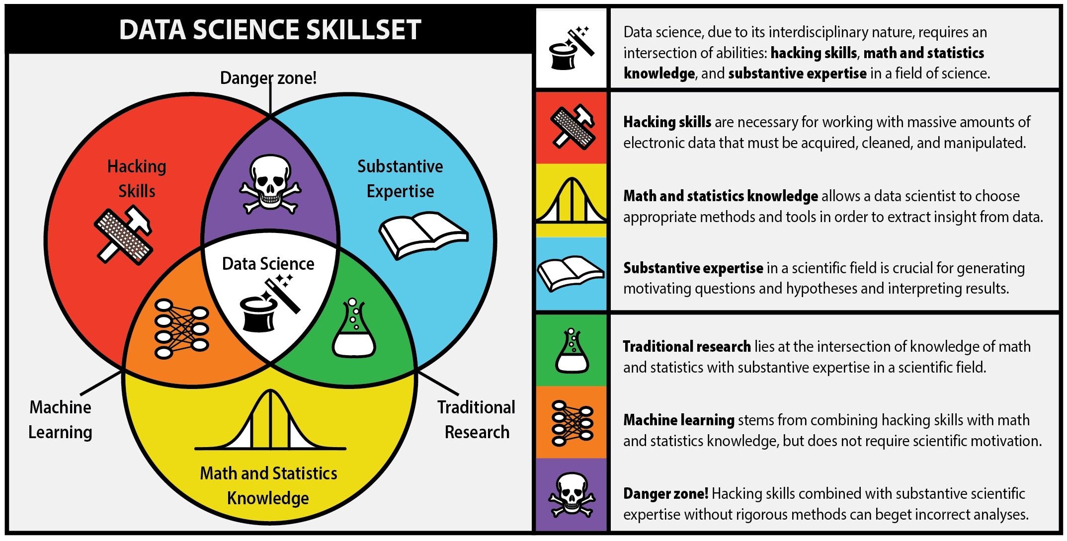
What is Data Science?
Article
Danger Zone: Spurious Correlations
Notes:
Image Source: The first rule of data science http://berkeleysciencereview.com/article/first-rule-data-science/
http://www.tylervigen.com/spurious-correlations

Slide 5
Why Learn Data Science?
Data Scientist: The Sexiest Job of the 21st Century
(Harvard Business Review)
IBM Predicts Demand For Data Scientists Will Soar 28% By 2020 (Forbes)
50 Best Jobs in America, 2017 (Glassdoor)
The world’s most valuable resource is no longer oil, but data
(The Economist)

Slide 6





Who Uses Data Science?

Slide 7
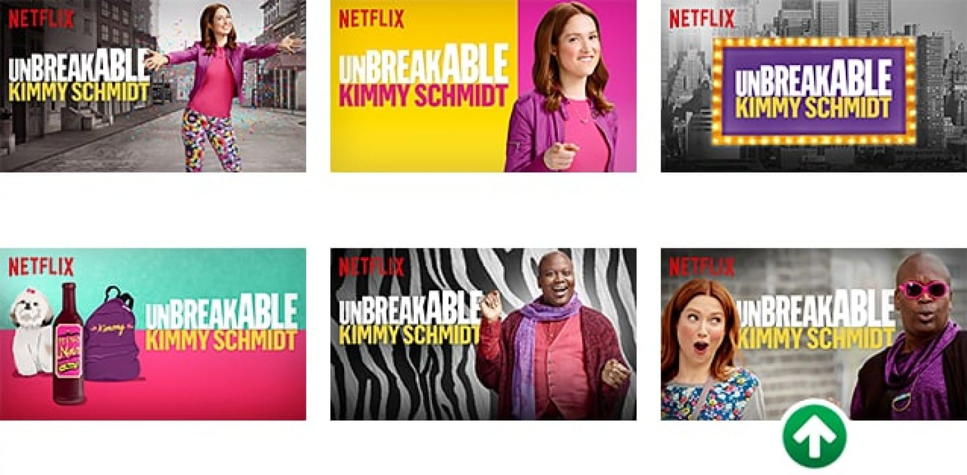
Netflix Example
Article

Slide 8
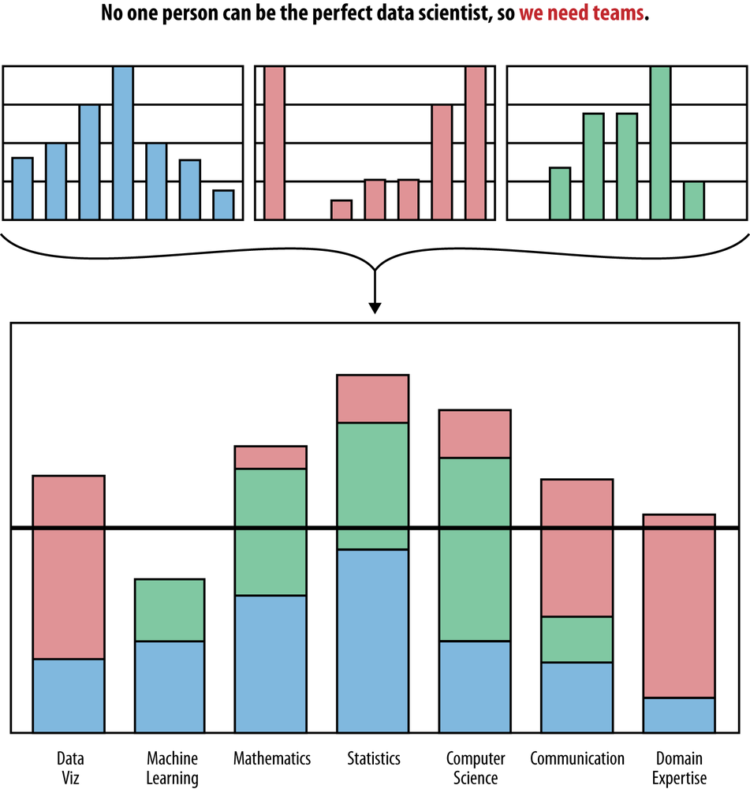
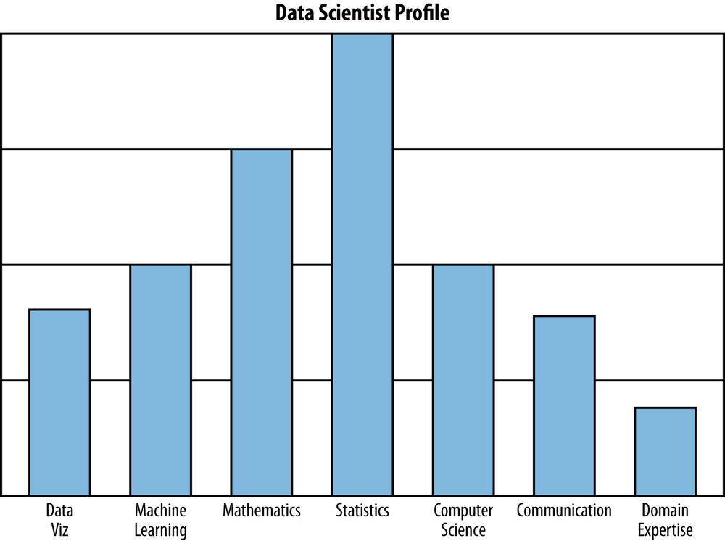
Data Science Roles

Slide 9
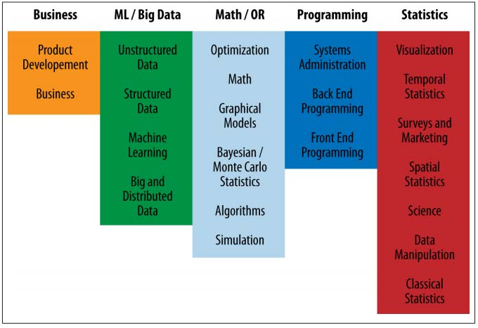
Data Science Skills
Involves a variety of skills, not just one
Notes:
OR = Operations Research

Slide 10
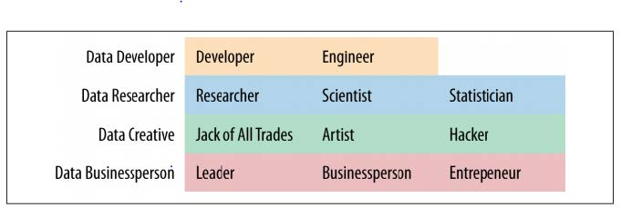
Data Science Roles
Involves a variety of roles, not just one

Slide 11
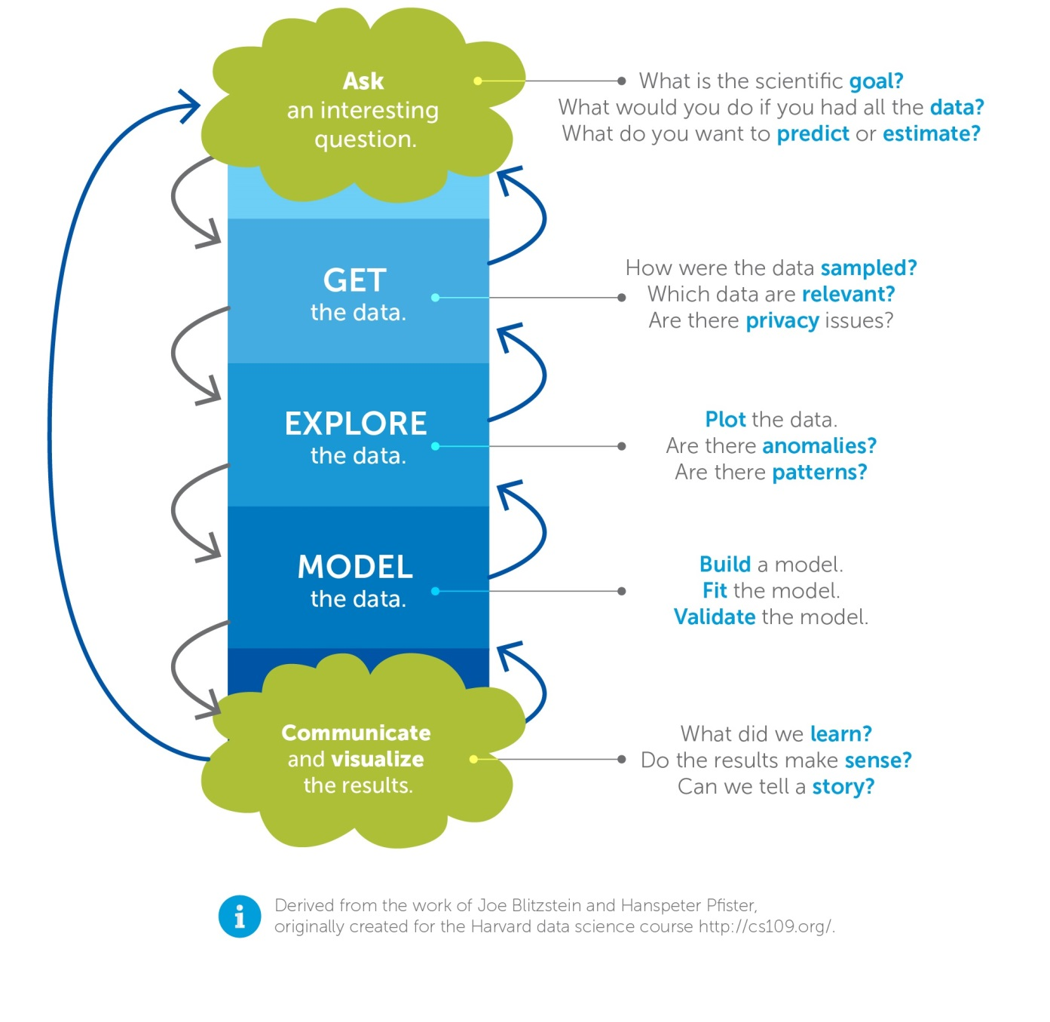
Data Science Workflow

Slide 12
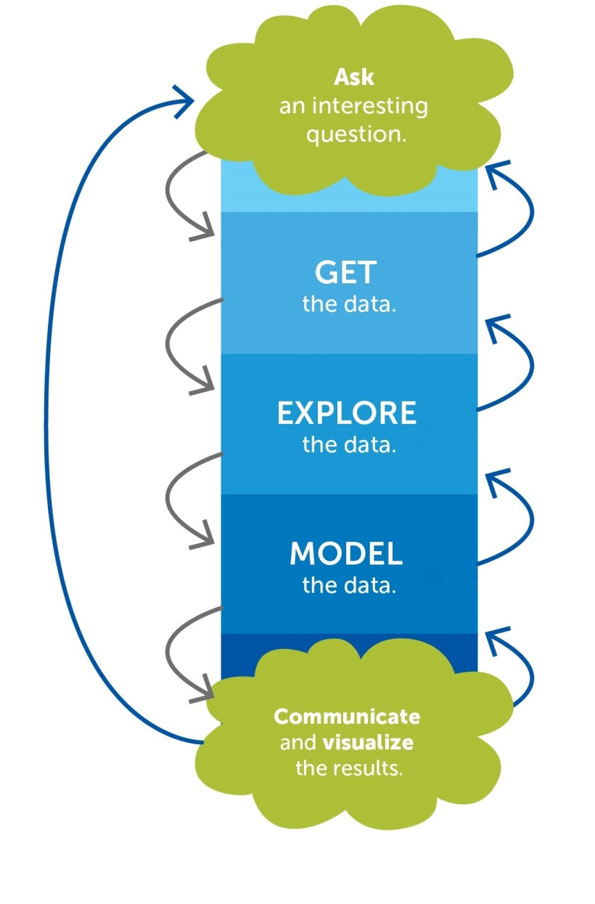
Data Science Workflow
Step 1: Ask an Interesting Question
Identify business/product objectives
Identify and hypothesize goals and criteria for success
Create a set of questions for identifying correct data set

Slide 13
Data Science Workflow
Step 2: Get the Data
Identify the “right” data set(s)
Import data and set up local or remote data structure
Determine most appropriate tools to work with data

Slide 14
Data Science Workflow
Step 3: Explore the Data
Read documentation provided with the data
Perform exploratory data analysis
Verify the quality of the data

Slide 15
Data Science Workflow
Step 4: Model the Data
Determine sampling methodology and sample data
Format, clean, slice, and combine data
Create necessary derived columns from the data
Identify trends and outliers
Document and transform data
Build model
Evaluate and refine model

Slide 16
Data Science Workflow
Step 5: Communicate Results
Summarize findings with narrative, storytelling techniques
Present limitations and assumptions of your analysis
Identify follow up problems and questions for future analysis

Slide 17
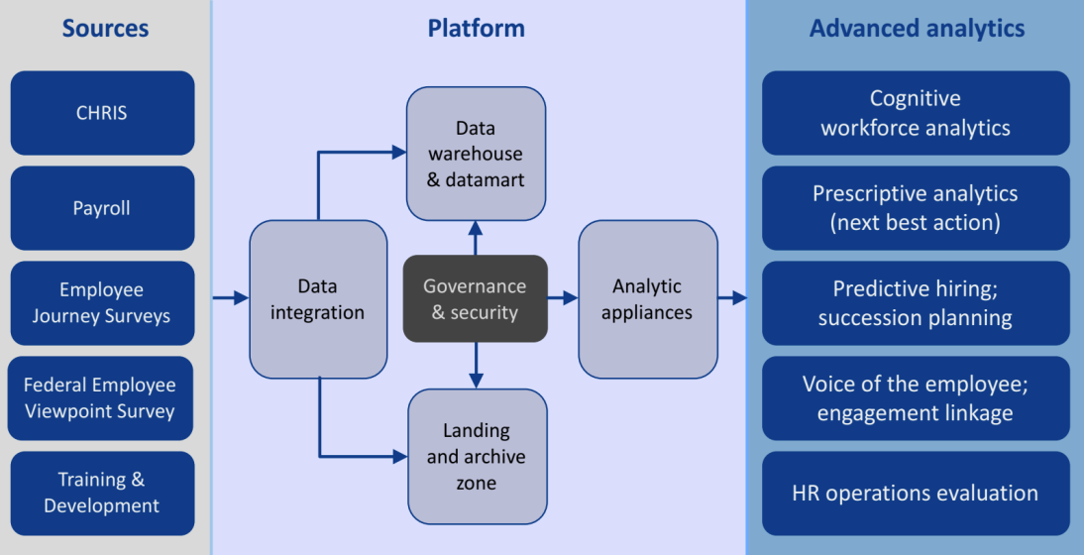
Federal Government Example
Office of Human Capital Strategy & Management (OHRM) carried out a study on Performance Management
Figure 1. HRDW conceptual framework
E-mail me for further documentation if you are interested

Slide 18
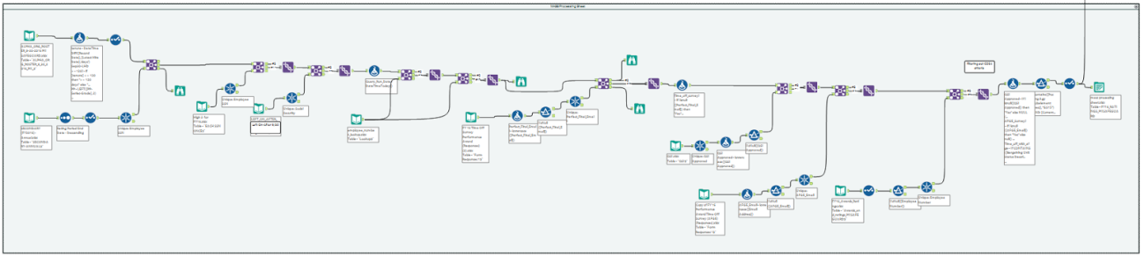
Federal Government Example
Figure 2. Data management workflow

Slide 19
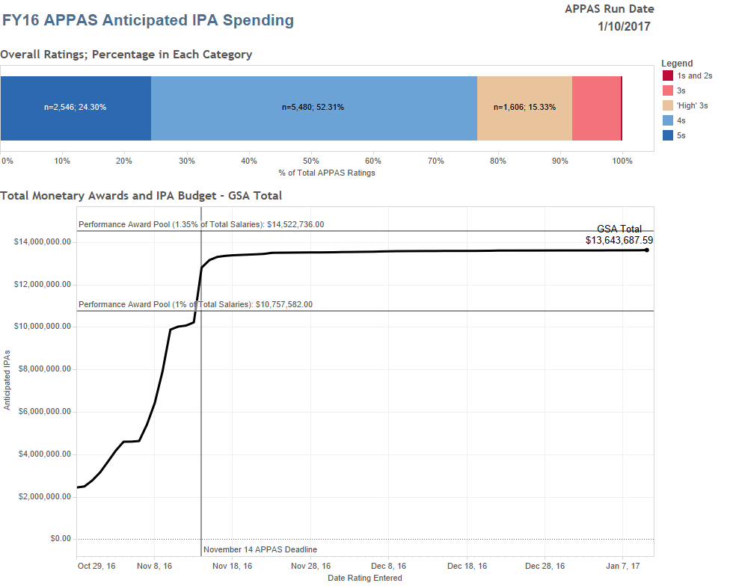
OHRM: Real-Time Analysis
Figure 3. Real-time spend analysis: A real-time spending analysis tool displayed cost projections on over $13.6 million in award spending and over 40,000 hours of award leave. The dashboard, updated daily, provided current progress and projections towards reaching awards budget limits. Analysis at the aggregate, organizational, and individual levels helped agency leaders more proactively determine the impact of performance award percentages.

Slide 20
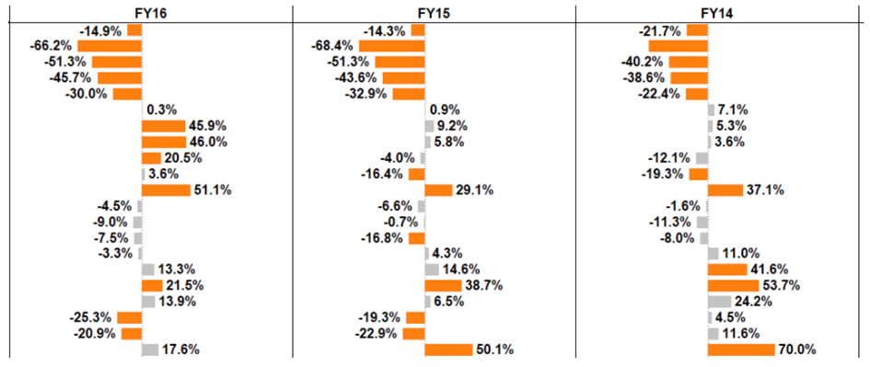

OHRM: Statistical Analysis on Bias
Figure 4. Descriptive statistical model: Multi-year statistical models visualized factors most associated with performance ratings outcomes, identifying statistical significance, magnitude, directionality and change over time (variable names are hidden). Percentages indicate the probability of an employee having received the next higher performance rating for each variable, holding other model variables constant.
Notes:
Using four years of ratings data, the analysis identified workforce attributes that were most statistically associated with higher performance ratings. These include position-related data such as grade, tenure, supervisory status, job series, business line), demographics (gender, age, race/national origin, veterans status, etc.) and interestingly, supervisory-to-employee differences (such as the age difference between the rater and ratee).
OHRM shared the findings with agency leaders in a dashboard (descriptive statistical model, figure 4). The statistical analysis produced a better understanding of the underlying factors most associated with ratings distributions, such as identifying portions of the workforce most likely to receive high ratings, evaluating changes across fiscal years, and measuring disparities in results among diverse employees. These findings were incorporated into an unconscious bias training program for managers offered by the Office of Civil Rights.

Slide 21
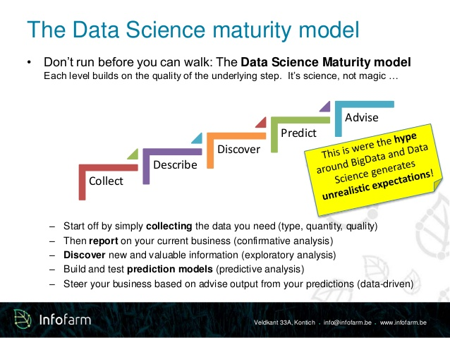

Slide 22
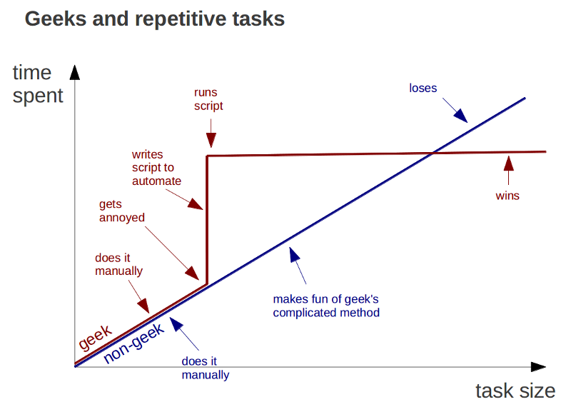
Why not Excel?

Slide 23
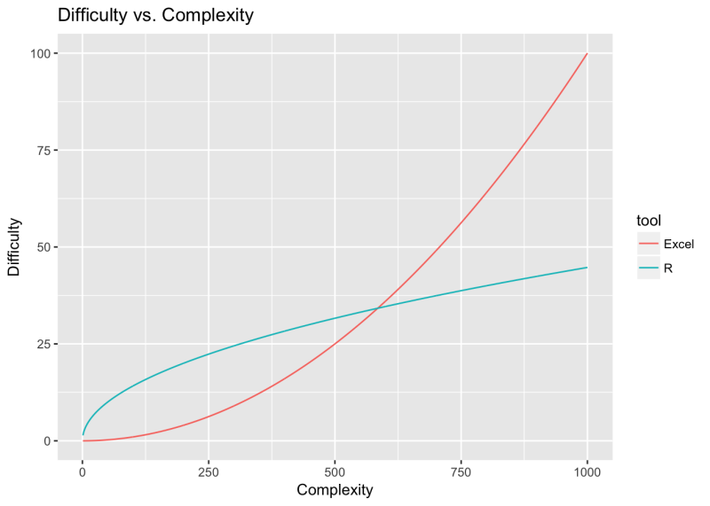
Why not Excel?

Slide 24
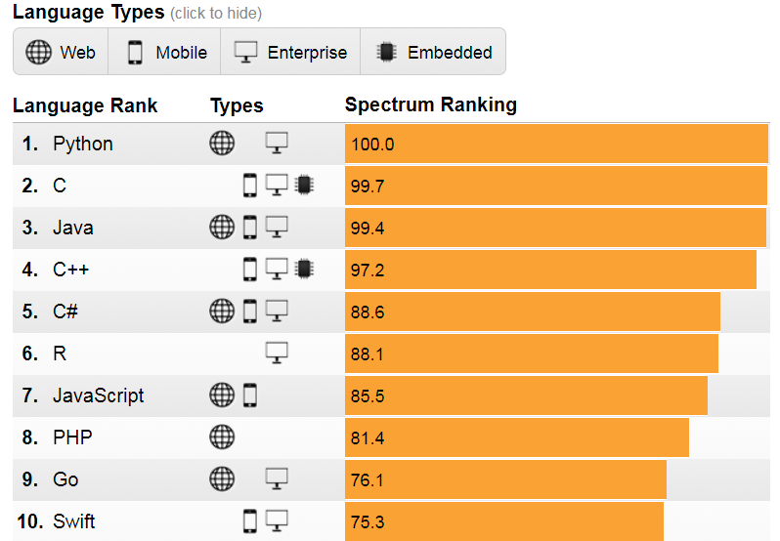
Why Python and R?
R and Python are the two most popular programming languages used by data analysts and data scientists.
Both are free and open source, and were developed in the early 1990s—R for statistical analysis and Python as a general-purpose programming language.

Slide 25
Why Python and R?
Created for simplicity and readability
Rapid prototyping, ease of production
Open source, importable libraries/packages
Broad range of applications
Fast growing community

Slide 26
Why Python and R?
Java
import javax.swing.JFrame; //Importing class JFrame
import javax.swing.JLabel; //Importing class JLabel
public class HelloWorld {
public static void main(String[] args) {
JFrame frame = new JFrame(); //Creating frame
frame.setTitle("Hi!"); //Setting title frame
frame.add(new JLabel("Hello, world!")); //Adding text to frame
frame.pack(); //Setting size to smallest
frame.setLocationRelativeTo(null); //Centering frame
frame.setVisible(true); //Showing frame
}
}
C
#include
int main(void)
{
puts("Hello, world!");
}
R
cat('Hello, world! ')
Python
print(‘Hello, world')
Notes:
https://excelwithbusiness.com/blog/say-hello-world-in-28-different-programming-languages/

Slide 27
Python vs R
R has an edge in statistics and visualization (these things are syntactically simpler)
Python has the edge in machine learning capabilities and connecting analyses to webapps.
Many advanced Data Scientists learn and use both, switching between the two to handle different tasks.
Choosing which language to start with depends on your situation. Here’s a link for a more in-depth analysis

Slide 28
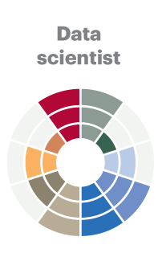
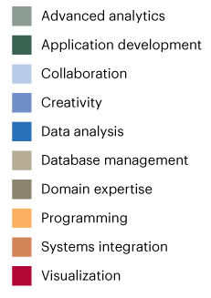
Expectations on What We’ll Learn
You WILL NOT become a full-fledged Data Scientist after this course.
You WILL become familiar enough with Python and R to teach yourself how to read documentation and learn how to become a Data Scientist.
The curiosity advantage: the most important skill for data science
(O’Reilly)

Slide 29
Contact Information
Jonathan Joa – Jonathan.Joa@gsa.gov
Scott McAllister – Scott.McAllister@gsa.gov

